Slide 1



Music & Text Generation
SIC 5
Notes:
Note:

Slide 2

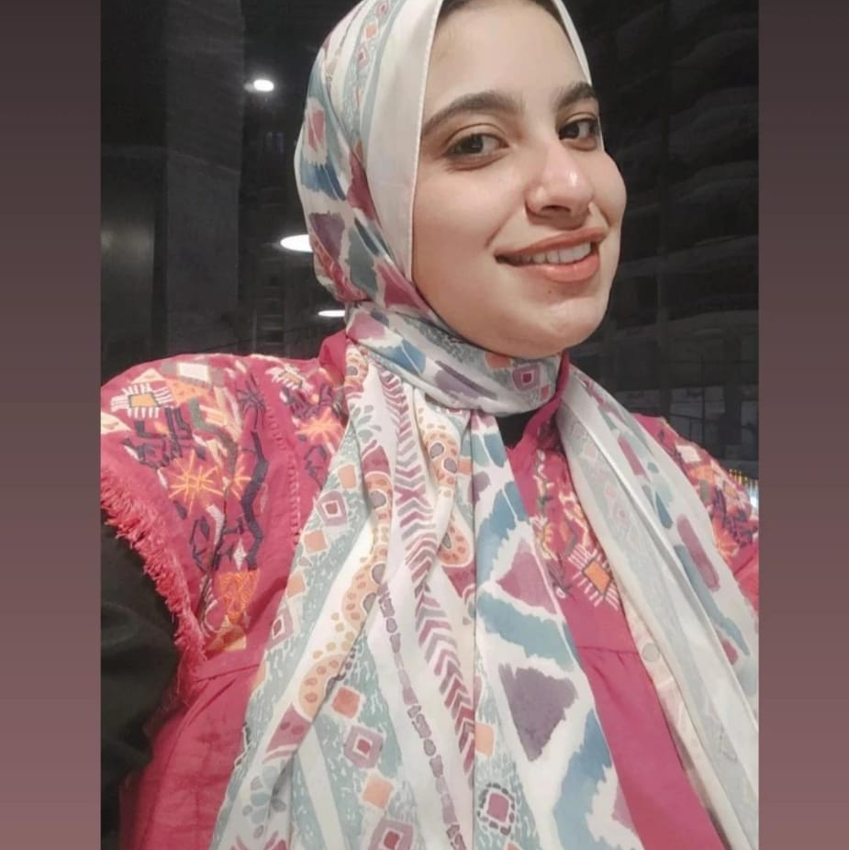
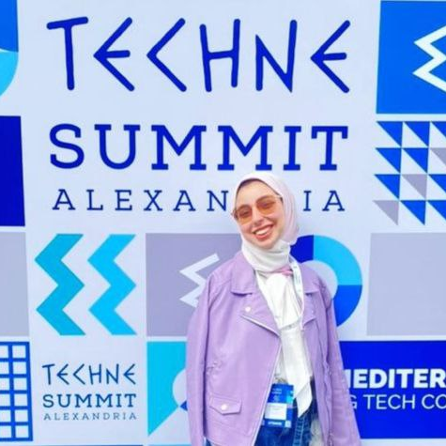
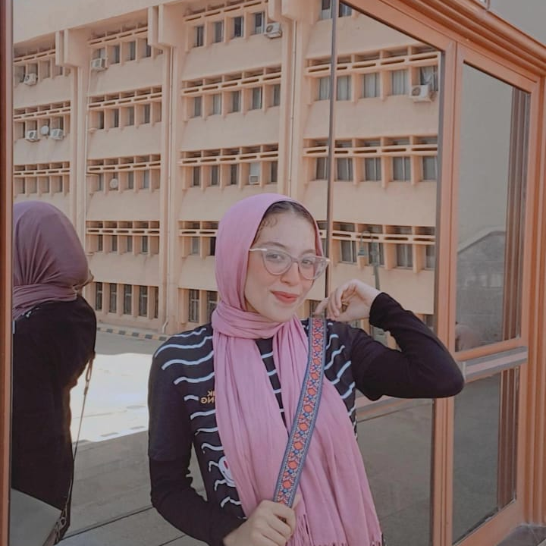
Our Team
Mennatullah Elsahy
Hajar Elbehairy
Rehab Ahmed
Notes:
Note:

Slide 3
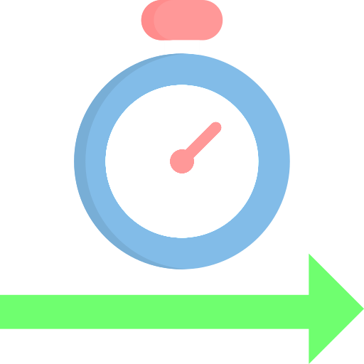









Our Journey
ARCHITECTURE
DEVELOPMENT
Future Work
DEPLOYMENT
Problem
CONTENT
TEG
PG
Notes:
Note:

Slide 4



Problem
stress was reported to be a common mental disorder and affected more than 300 million people worldwide
Music listening has been suggested to beneficially impact health via stress-reducing effects.
Notes:
Note:

Slide 5





Our Adventures
Poem Generation
Sentiment Analysis
Music Generation
Notes:
Note:

Slide 6

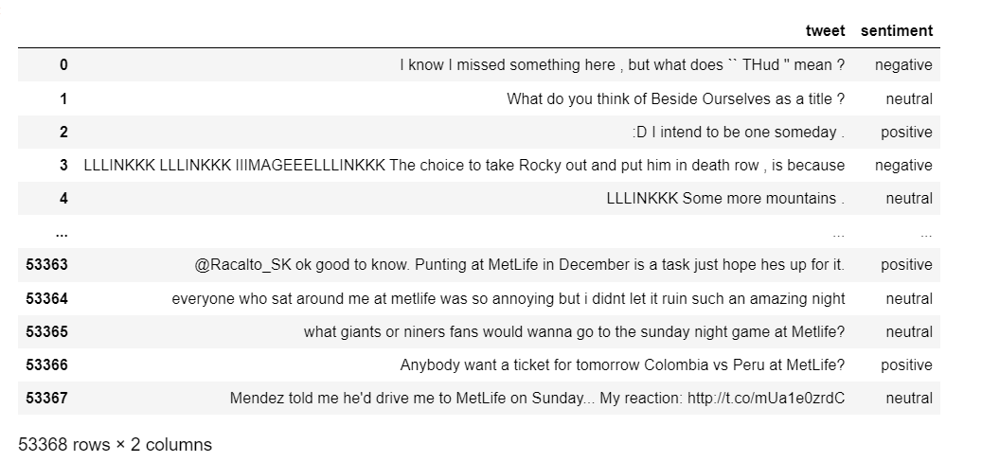
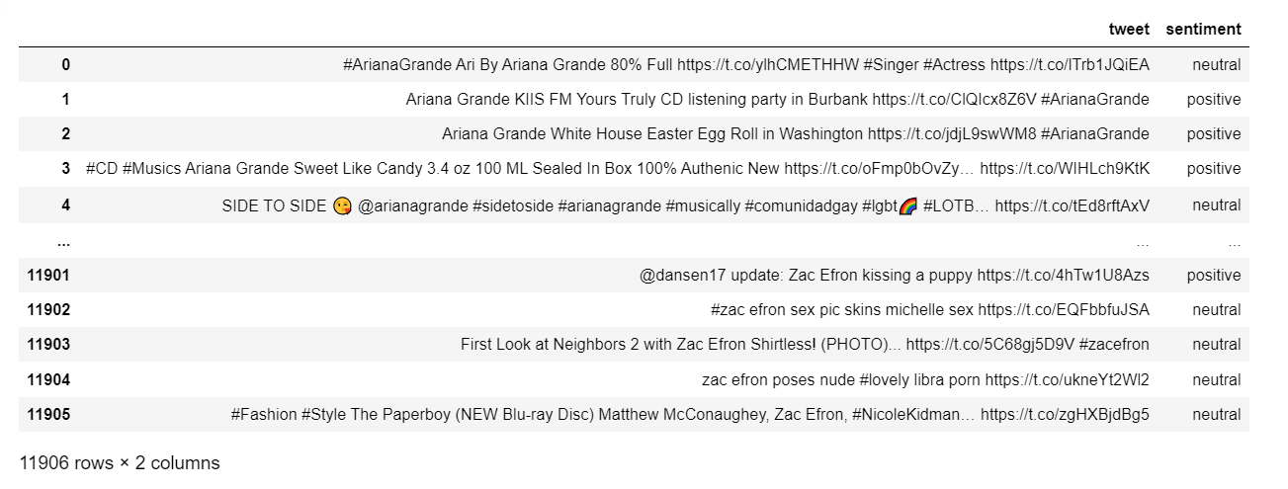
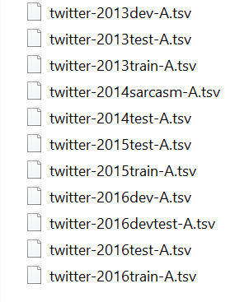
Twitter Data
SemEval is a series of international natural language processing (NLP) research workshops whose mission is to advance the current state of the art in semantic
Notes:
Note:

Slide 7

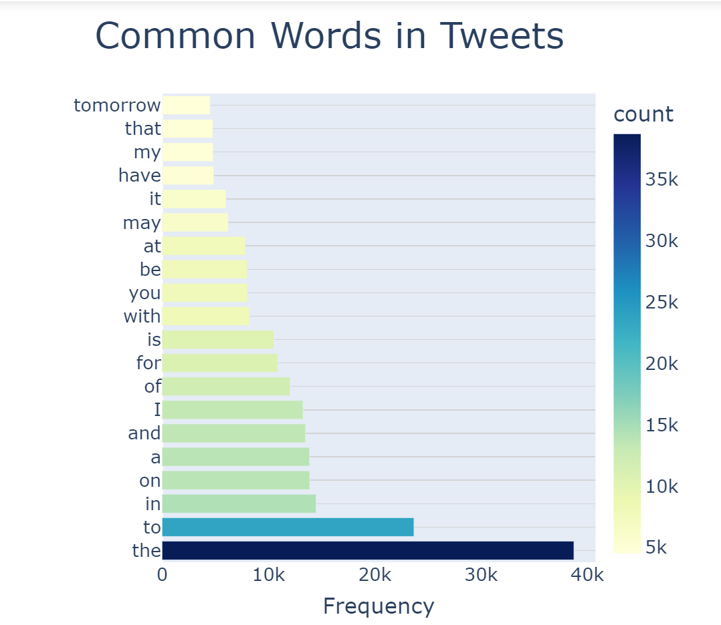

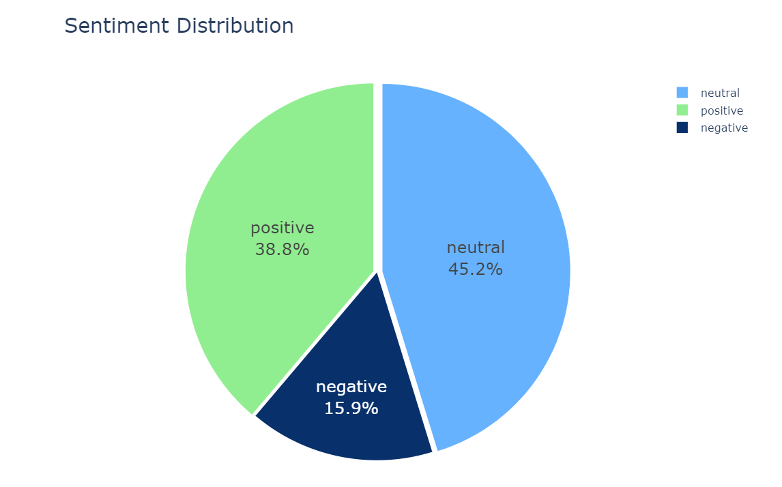
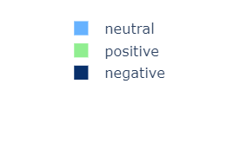
EDA
Notes:
Note:

Slide 8

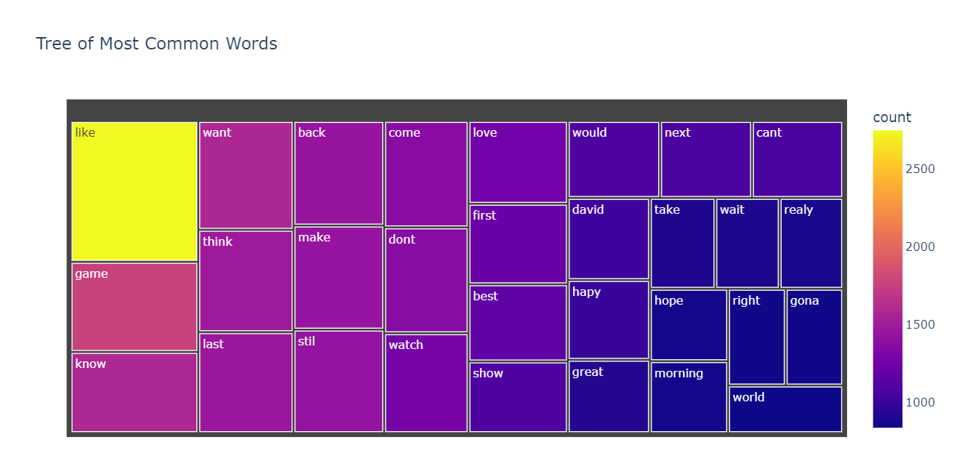
Preprocessing
1- Remove Stop Words
2- Random URLs, Mentions, Tags & emojis
3- Tokenization
4- Limitations
5- lowercase
6- Remove Time period & numbers
7- Remove Repeated words
8- Expand Contractions
9- Remove Extra Spaces
Notes:
Note:

Slide 9

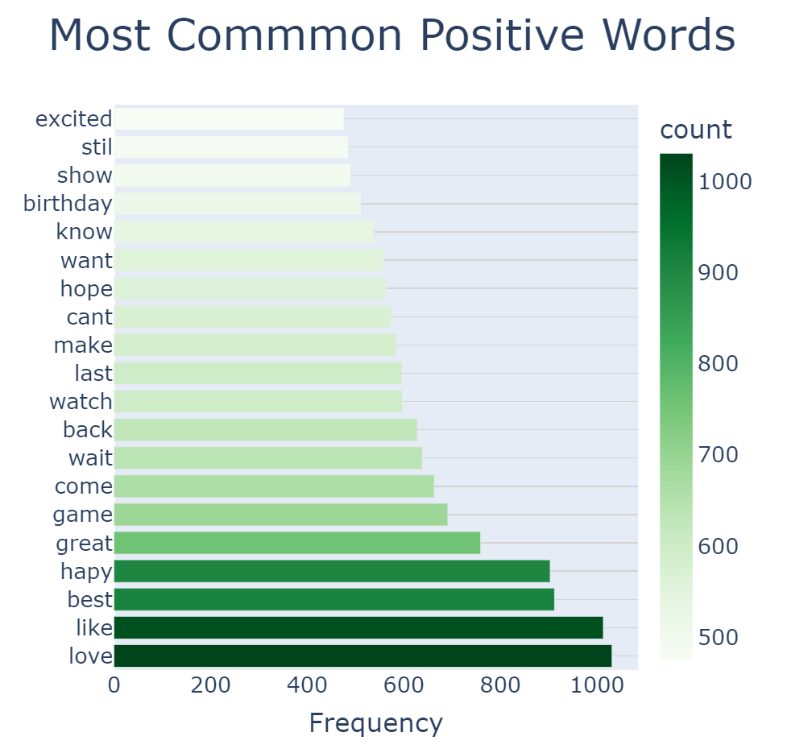
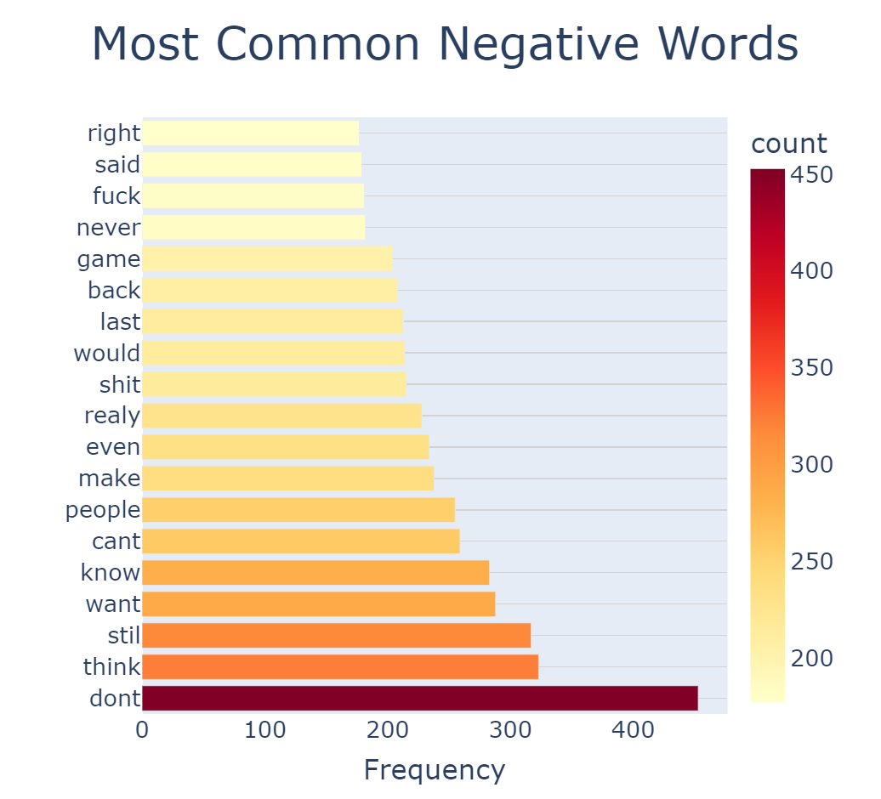
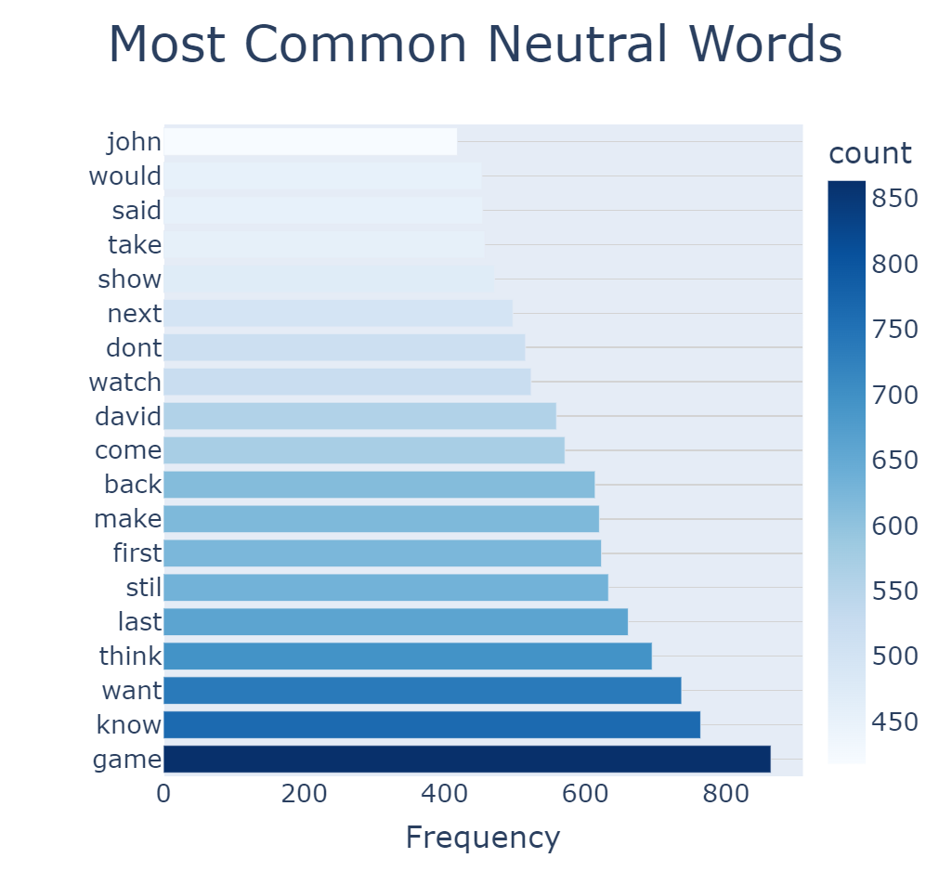
Visualization
Notes:
Note:

Slide 10

Model Applied
1- LSTM glove
2- Bidirectional LSTM glove
3- Naïve Bayes (BOW)
4- Naïve Bayes (TF-IDF)
Notes:
Note:

Slide 11
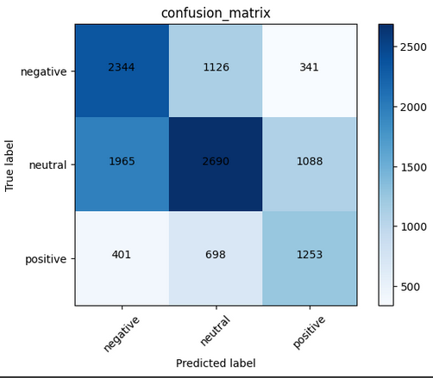
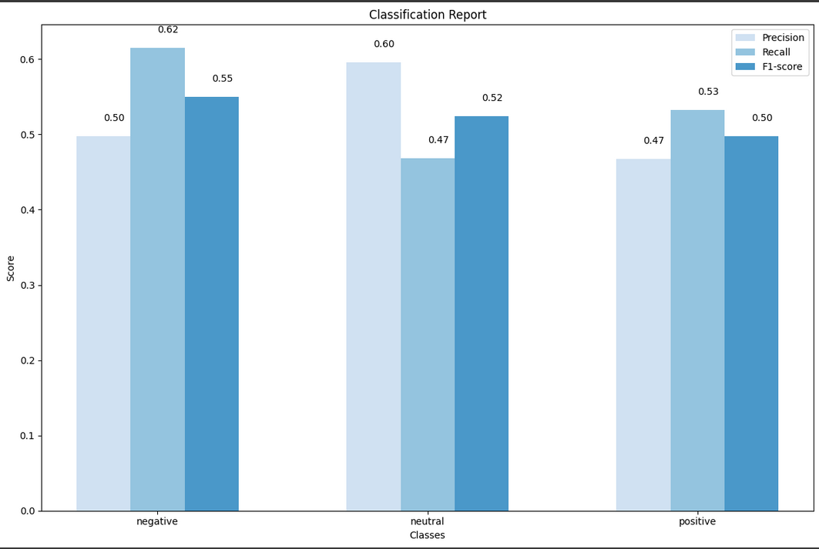
Model Applied
LSTM glove
Notes:
Note:

Slide 12
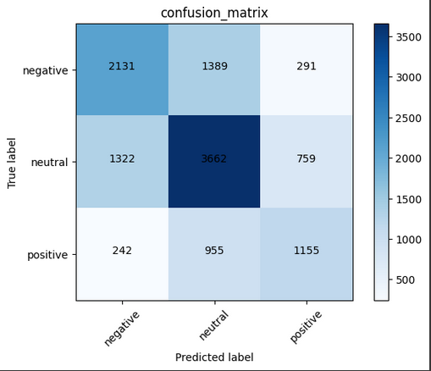
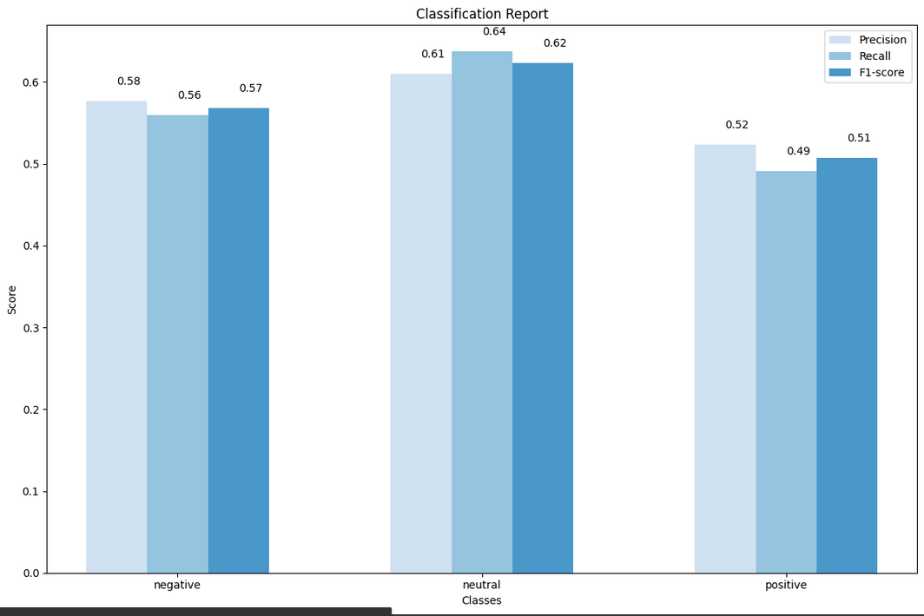
Model Applied
Bidirectional LSTM glove
Notes:
Note:

Slide 13
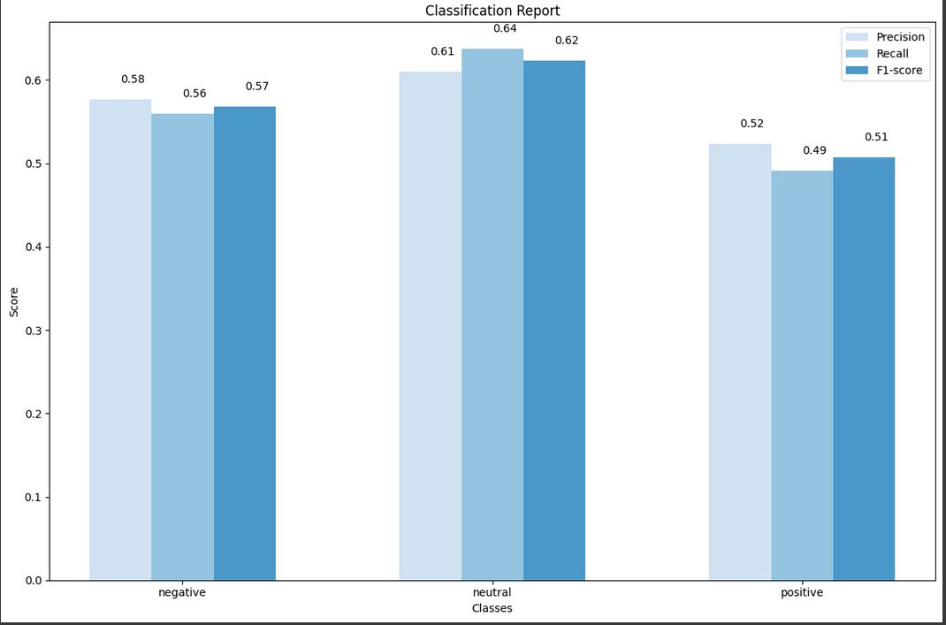
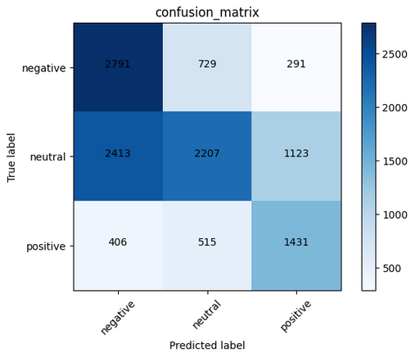
Model Applied
Naïve Bayes (BOW)
Notes:
Note:

Slide 14
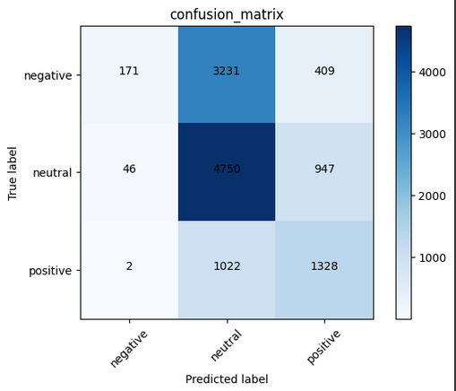

Model Applied
Naïve Bayes (TF-IDF)
Notes:
Note:

Slide 15
Model Applied
Conclusions
Notes:
Note:

Slide 16

Model Applied
HuggingFace's bertweet
Transformer Model
Notes:
Note:

Slide 17

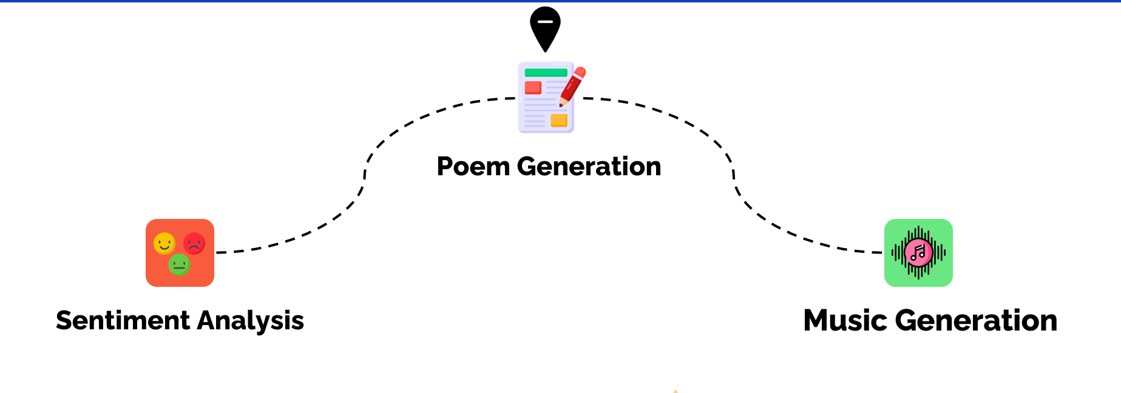
Our Adventures
Poem Generation
Sentiment Analysis
Music Generation
Notes:
Note:

Slide 18

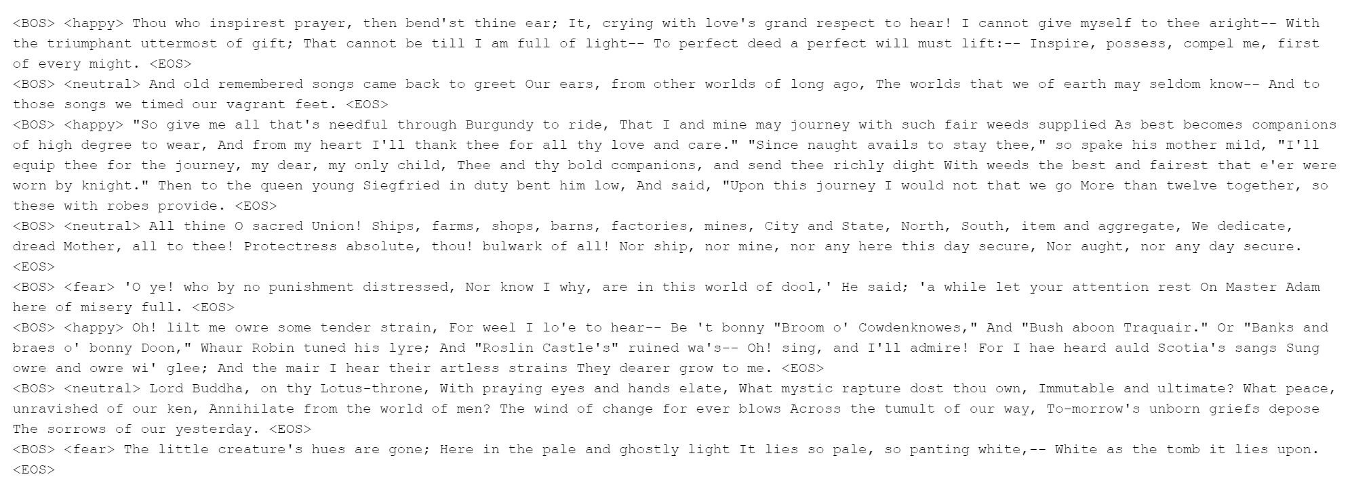
Poem Data
Notes:
Note:

Slide 19
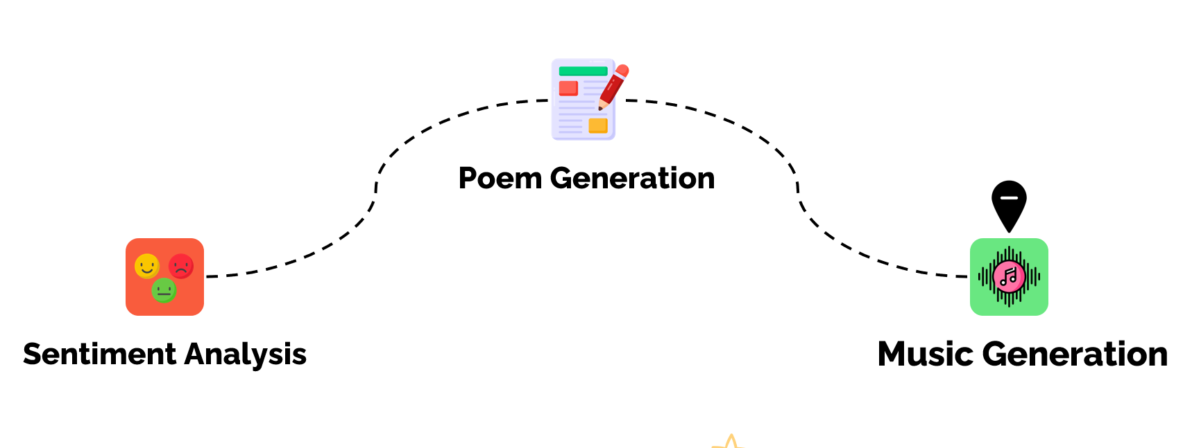
Our Adventures
Poem Generation
Sentiment Analysis
Music Generation
Notes:
Note:

Slide 20
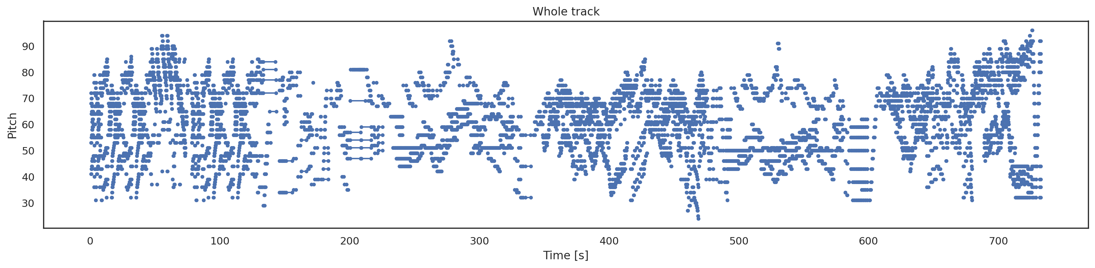
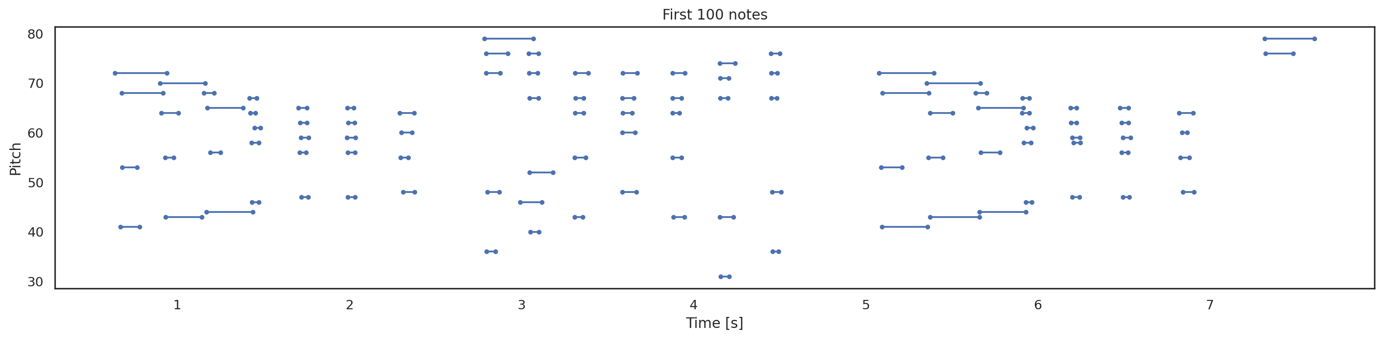
EDA
Notes:
Note:

Slide 21
Preprocessing
Notes:
Note:

Slide 22

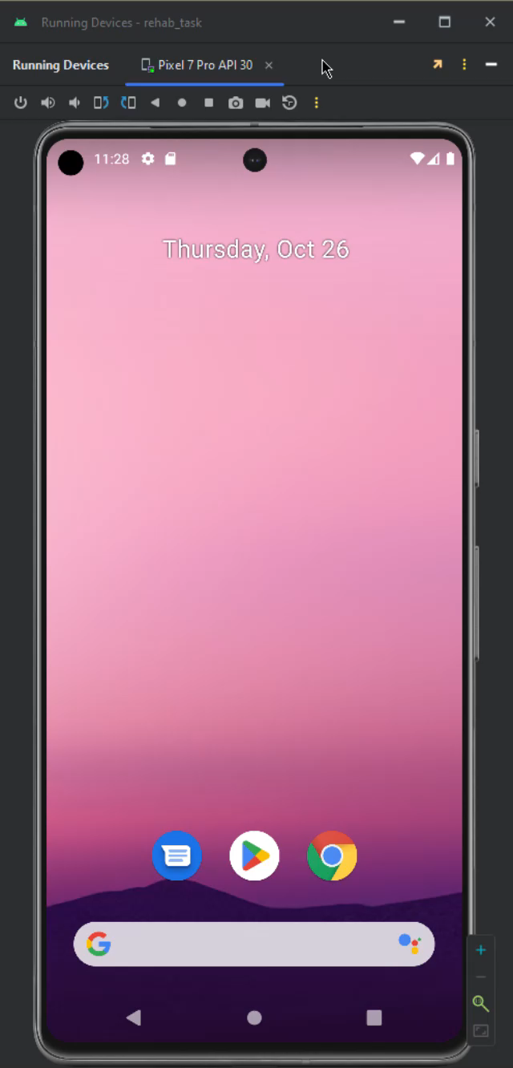
Our GUI
Notes:
Note:

Slide 23


Deployment & Demo
Streamlit User Interface: The user-friendly Streamlit interface makes it easy for users to interact with the application, providing a seamless experience for capturing images, analyzing emotions, and reading generated poems.
Notes:
Note:

Slide 24

Future Work
Notes:
Note:

Slide 25
Thanks!
Any Questions?

